Slide 1
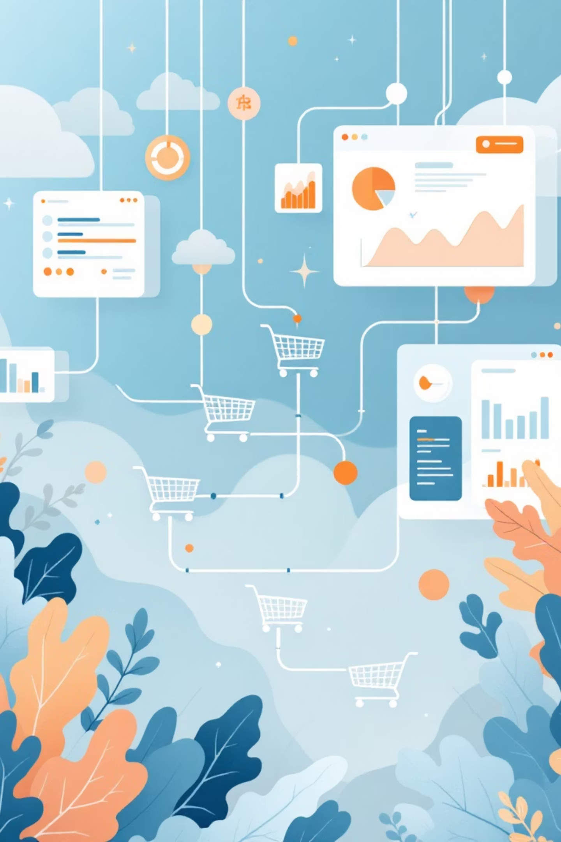
Customer Shopping Behavior Analysis
A data-driven project to understand and optimize retail strategies.

Slide 2

Project Overview
Analyze Transactions
Derive Insights
Support Decisions
3,900 purchases across diverse categories.
Spending patterns, segmentation, product performance, subscriptions.
Actionable insights for data-driven business choices.

Slide 3

Dataset Summary
Key Figures
Data Categories
Total Records: 3,900 rows
Customer Demographics
Total Attributes: 18 columns
Purchase Details
Missing Values: 37 in Review Rating
Behavioral Features

Slide 4

Exploratory Data Analysis (Python)
01
Data Loading & Inspection
Using Pandas for structural and statistical understanding.
02
Handle Missing Values
Median imputation for Review Rating by product category.
03
Feature Engineering
Created age_group and purchase_frequency_days.
04
Clean & Export
Standardized names, removed redundancy, exported to PostgreSQL.

Slide 5


Key Data Insights (SQL)
Revenue by Gender
Top Products
Shipping Impact
Male: $157,890, Female: $75,191.
Gloves, Sandals, Boots by review rating.
Express: $60.48 avg purchase; Standard: $58.46.

Slide 6



Customer Segmentation
Returning
701 customers
Loyal
3116 customers
New
83 customers

Slide 7

Subscription & Discount Analysis
Subscription Status
Discount Dependency
Subscribers: 1053 customers
Products like Hats, Sneakers, Coats highly discount-dependent.
Non-Subscribers: 2847 customers
Subscribers show slightly lower average spend.
High-spending customers identified using discounts.

Slide 8

Top Products & Age Group Revenue
Top Products by Category
Revenue by Age Group
Accessories: Jewelry, Sunglasses, Belt
Young Adult: $62,143
Middle-aged: $59,197
Clothing: Blouse, Pants, Shirt
Adult: $55,978
Footwear: Sandals, Shoes
Senior: $55,763

Slide 9
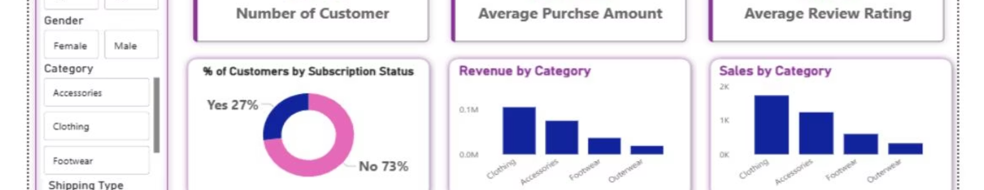
Dashboard Development
Interactive Power BI dashboard for key insights.
Accessible to technical and non-technical stakeholders for effective comparison.

Slide 10
Business Recommendations
Enhance Subscriptions
Offer exclusive incentives.
Implement Loyalty Programs
Convert returning customers.
Optimize Discounts
Maintain profitability.
Promote Top Products
Focus on highly-rated items.
Target Marketing
High-revenue age groups, express-shipping customers.

